Slide 1
SYNBIO CHALLENGES 2.0
HKBU-Pro (HKBU)
Zhang Zecheng
2023.08.05

Slide 2
Outline
Evaluation (Fitness):
Activity
Selectivity
Biochemical Analysis
Data Analysis
Method & Result
Given Data:
No Mutation 1
Single-point Mutation 114
Multi-point Mutation 1492
Target:
6 sites 74 / 101 / 143 / 148 / 173 / 176
2⁶*2*3 = 384 combinations
Notes:
分析目标
分析提供的数据的结构
选择策略

Slide 3
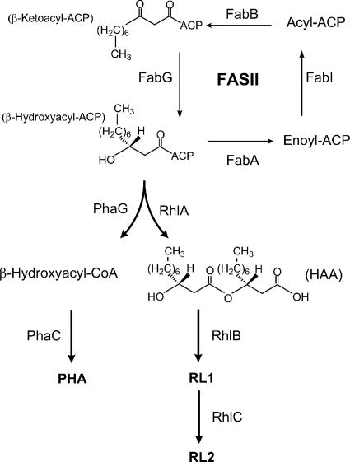
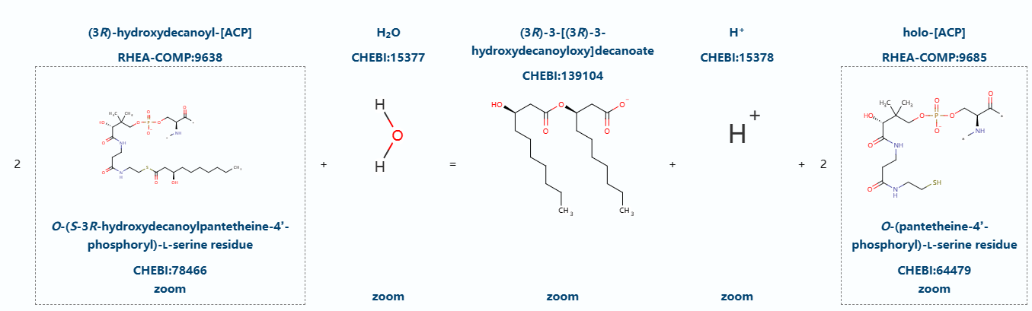
Q51559 · RHLA_PSEAE
3-(3-hydroxydecanoyloxy)decanoate synthase IN Pseudomonas aeruginosa
295 Amino acids
two fitness: ① Normalized Activity (production of the rhamnolipid (RL) congener)
② Normalized Selectivity (Rha-(C8-C10) ratio, while WT RhlA produced
Rha-(C10-C10) as the main product)
[1]. Zhu K, Rock CO. RhlA converts beta-hydroxyacyl-acyl carrier protein intermediates in fatty acid synthesis to the beta-hydroxydecanoyl-beta-hydroxydecanoate component of rhamnolipids in Pseudomonas aeruginosa. J Bacteriol. 2008 May;190(9):3147-54. doi: 10.1128/JB.00080-08. Epub 2008 Mar 7. PMID: 18326581; PMCID: PMC2347404.
[2]. rhlA - 3-(3-hydroxydecanoyloxy)decanoate synthase - Pseudomonas aeruginosa (strain ATCC 15692 / DSM 22644 / CIP 104116 / JCM 14847 / LMG 12228 / 1C / PRS 101 / PAO1) | UniProtKB | UniProt

Slide 4
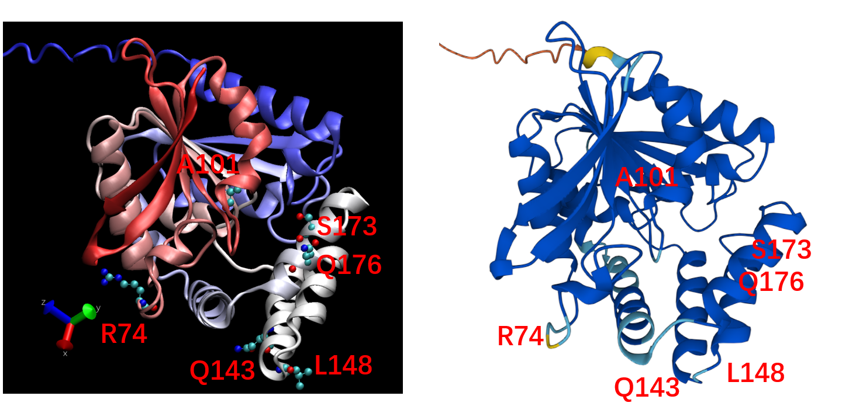
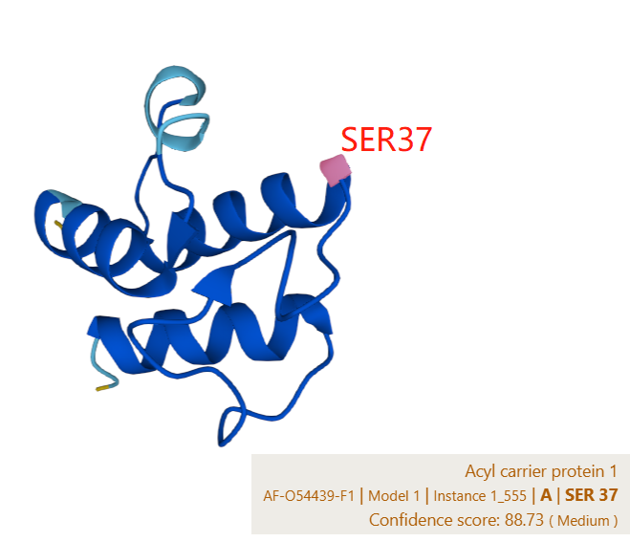
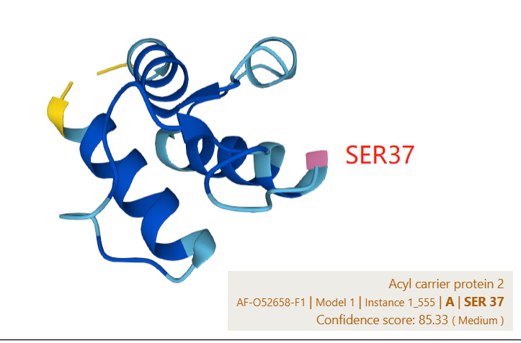
Q51559 · Structure

Slide 5
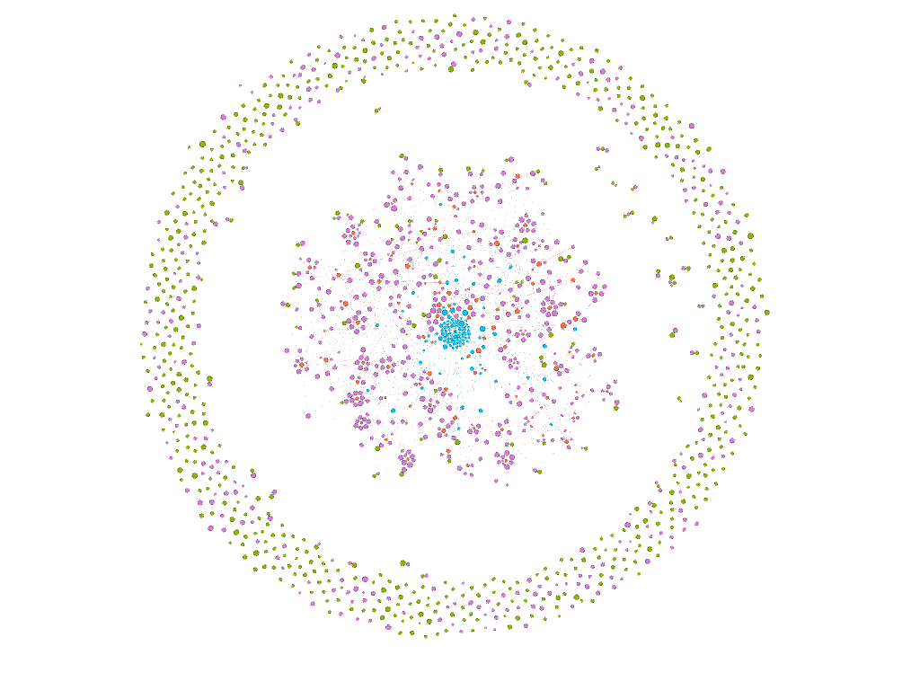
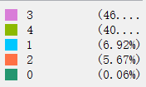
DATAset · Profile
mut sites | RAQLSQ | count | mut sites | RAQLSQ | count | mut sites | RAQLSQ | count
1 | 100000 | 19 | 2 | 110000 | 2 | 4 | 110110 | 653
1 | 010000 | 19 | 2 | 000110 | 34 | 3 | 100110 | 643
1 | 001000 | 16 | 2 | 100100 | 33 | 3 | 010110 | 38
1 | 000100 | 19 | 2 | 100010 | 15 | 3 | 110100 | 35
1 | 000010 | 19 | 2 | 010100 | 5 | 3 | 110010 | 32
1 | 000001 | 19 | 2 | 010010 | 2 | 0 | 000000 | 1
 | L | S | E | A | G | P | V | K | R | T | D | Q | I | F | N | Y | H | C | M | W
R | 65 | 74 | 52 | 206 | 64 | 141 | 53 | 76 | 172 | 137 | 51 | 99 | 48 | 37 | 73 | 51 | 73 | 47 | 49 | 36
A | 35 | 43 | 48 | 818 | 46 | 37 | 72 | 46 | 32 | 42 | 29 | 41 | 58 | 33 | 37 | 40 | 40 | 31 | 39 | 37
Q | 1 | 1 | 1 | 1 | 1 | 1 | 1 | 0 | 1 | 1 | 1 | 1588 | 0 | 1 | 1 | 1 | 1 | 1 | 0 | 1
L | 144 | 64 | 99 | 76 | 55 | 44 | 68 | 130 | 83 | 86 | 78 | 118 | 79 | 55 | 76 | 58 | 62 | 116 | 56 | 57
S | 181 | 168 | 42 | 103 | 53 | 40 | 60 | 111 | 141 | 144 | 42 | 45 | 67 | 51 | 39 | 53 | 35 | 113 | 72 | 44
Q | 1 | 1 | 1 | 1 | 1 | 1 | 1 | 1 | 1 | 1 | 1 | 1585 | 1 | 1 | 1 | 1 | 1 | 1 | 1 | 1

Slide 6
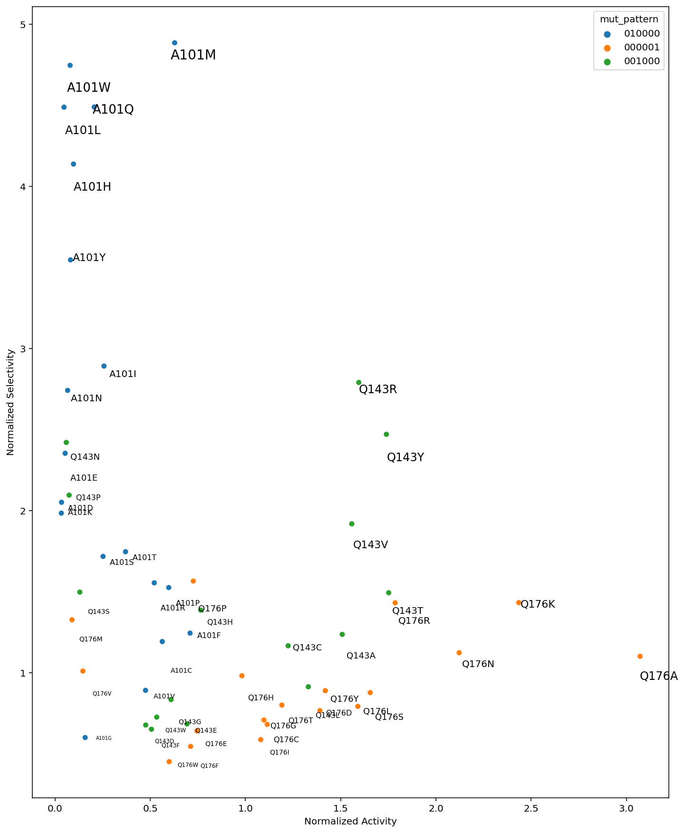
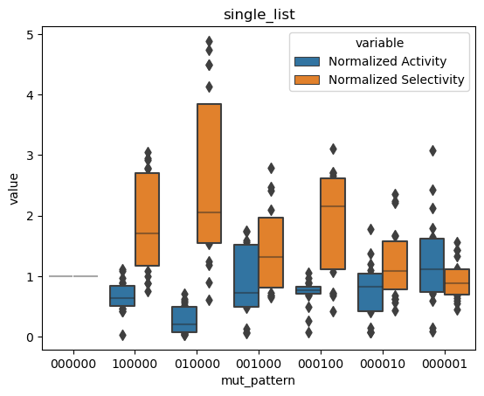
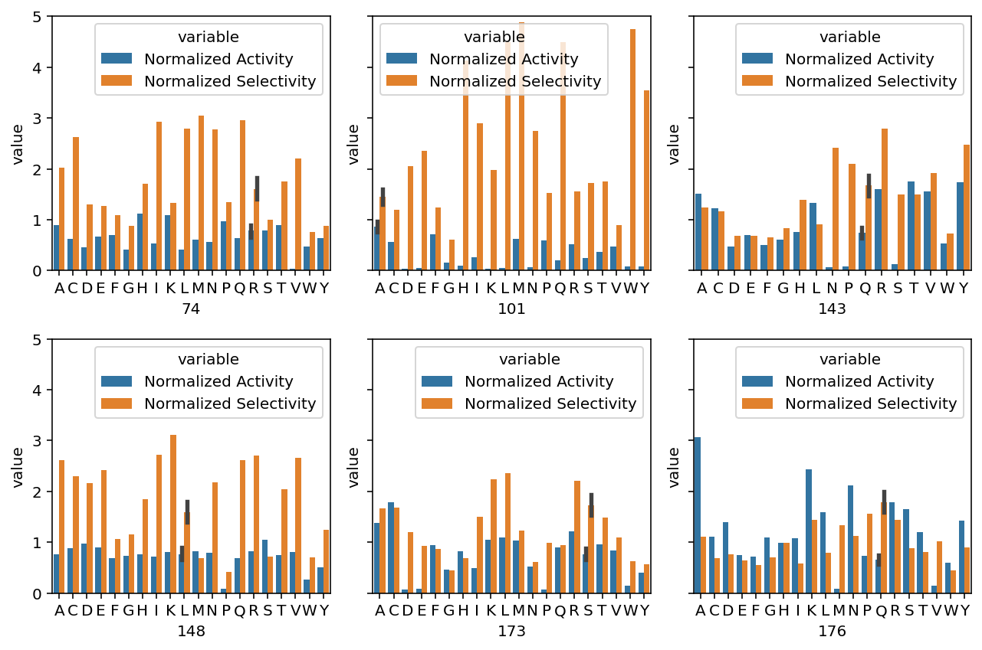
Fitness · Analyse
RAQLSQ | count
100000 | 19
010000 | 19
001000 | 16
000100 | 19
000010 | 19
000001 | 19
000000 | 1

Slide 7
Method & Pepline
Experiment Data
Model Evaluation
Spearman correlation
Filter
Activity, Selectivity, Prod of A & S
Combinations of Data
X1,X2….X6
X1,X2…; X1*X2…
X1,X2…; X1*X2…; X1/X2
Regression Model
Linear Reg
Lasso Reg
Result

Slide 8
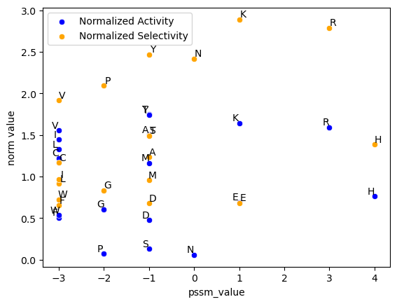
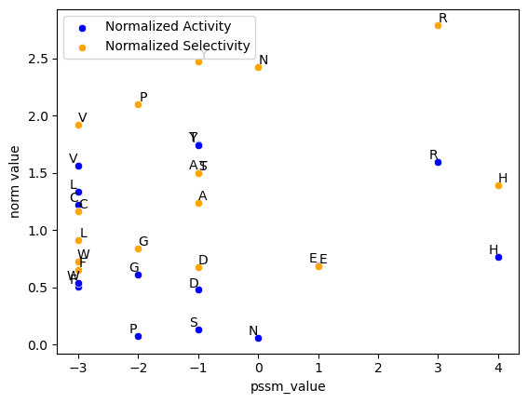
PSSM Matrix
Data Imputation
147 site
I (Ile)
K (Lys)
M (Met)
L/V
R/(H,E)
(A,D…)

Slide 9
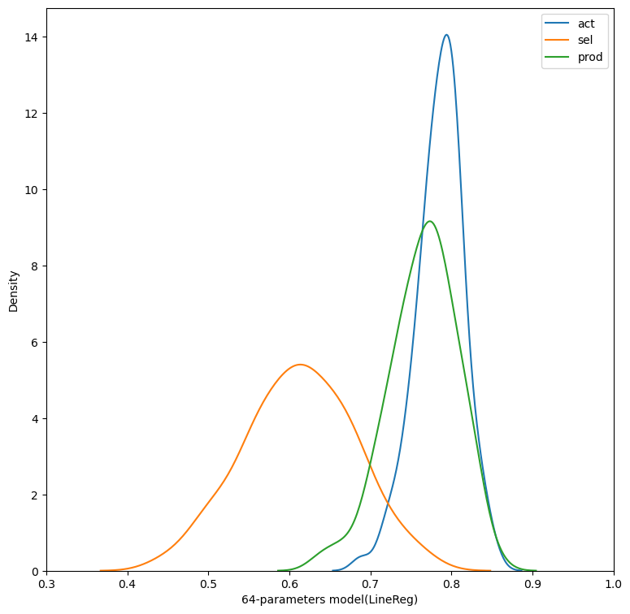
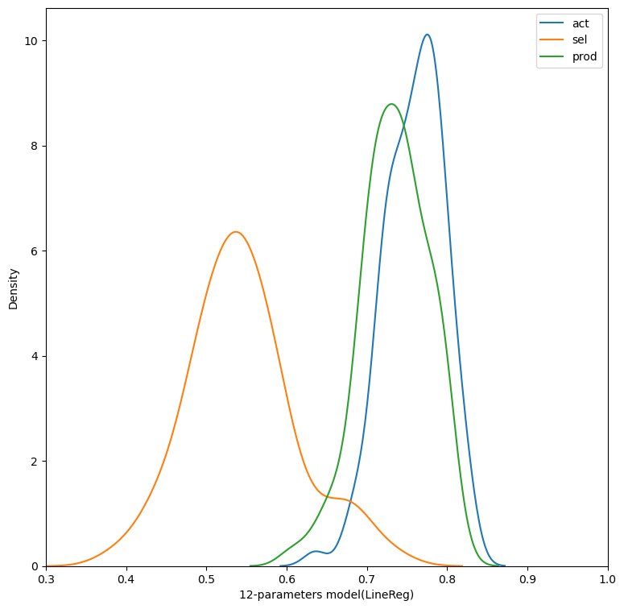
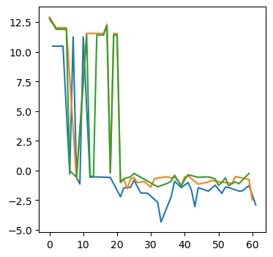
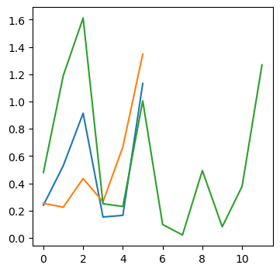
Too complicate v.s. Too simple (Linear Regression)
↓： spearman coefficients of random sampling from [prediction, reality] ↓
←(6 + 15) * 3 + 1
(logged coef)
→ 6 / 6 / 6 * 2

Slide 10
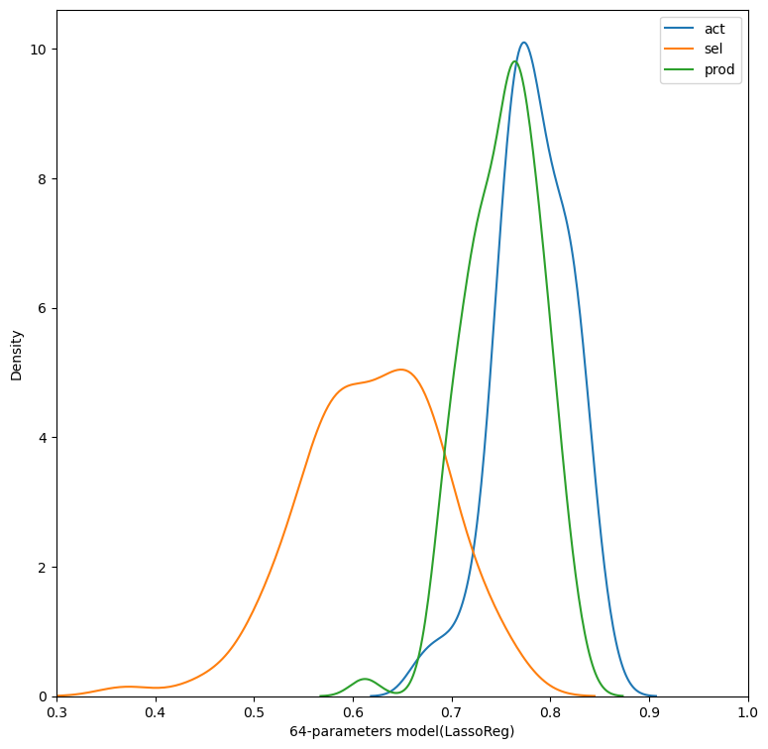
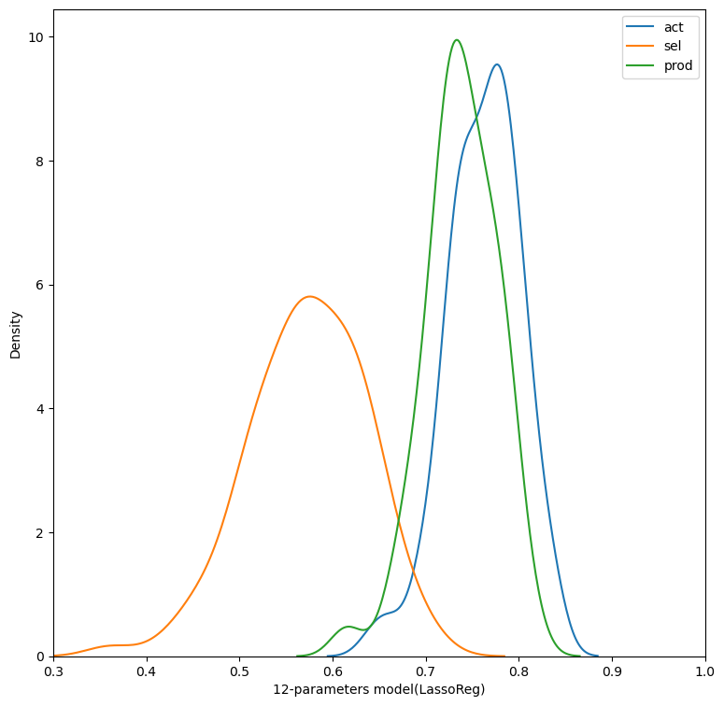
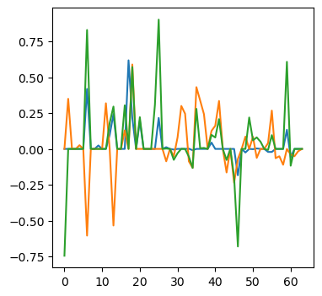
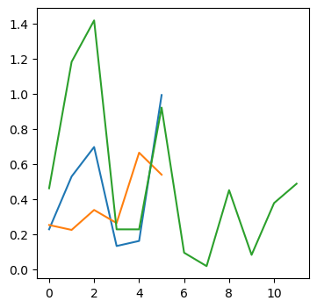
Too complicate v.s. Too simple (Lasso Regression)
↓： spearman coefficients of random sampling from [prediction, reality] ↓
←(6 + 15) * 3 + 1
→ 6 / 6 / 6 * 2

Slide 11
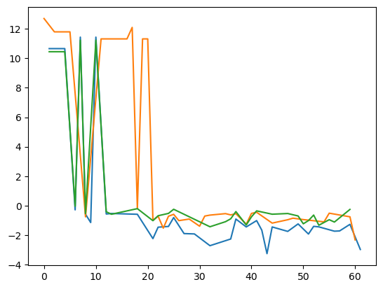
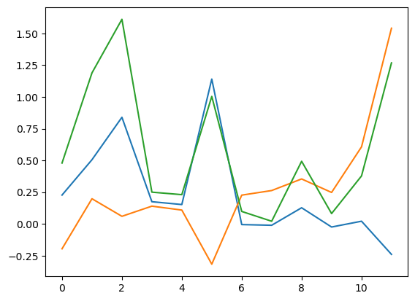
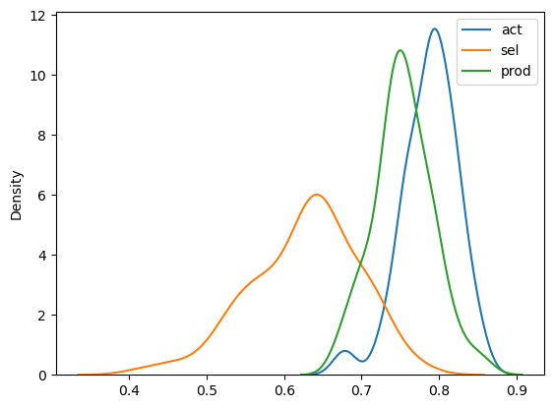
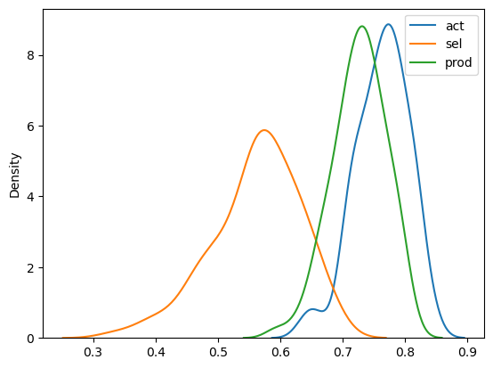
Too complicate v.s. Too simple
over fitting
Left: logged coefficient number for X1,x2…x1*x2….x1/x2
Right: coefficient number for x1,x2…
↓：spearman coefficients of random sampling after fitting

Slide 12
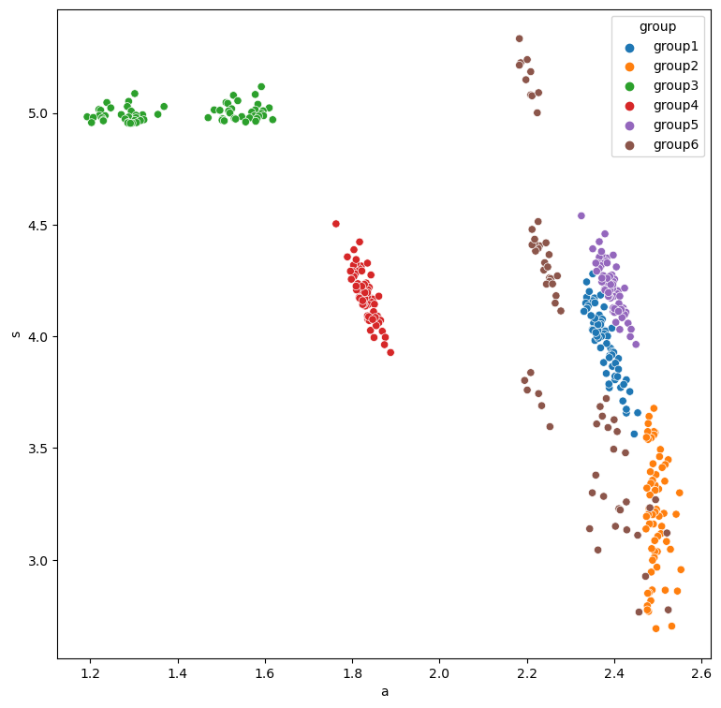
group | mutation sites | chosen fitness
1 | 4 | prod
2 | 4 | activity
3 | 4 | selectivity
4 | 4 from first 5 | prod
5 | 5 | prod
6 | 3 | prod
 | 6
6 rules
Top 64 combinations for each rule
Rule No. | Mutation Sites | Chosen Fitness
1 | 4 | prod
2 | 4 | activity
3 | 4 | selectivity
4 | 4 from first 5 | prod
5 | 5 | prod
6 | 3 | prod
 | 6

Slide 13
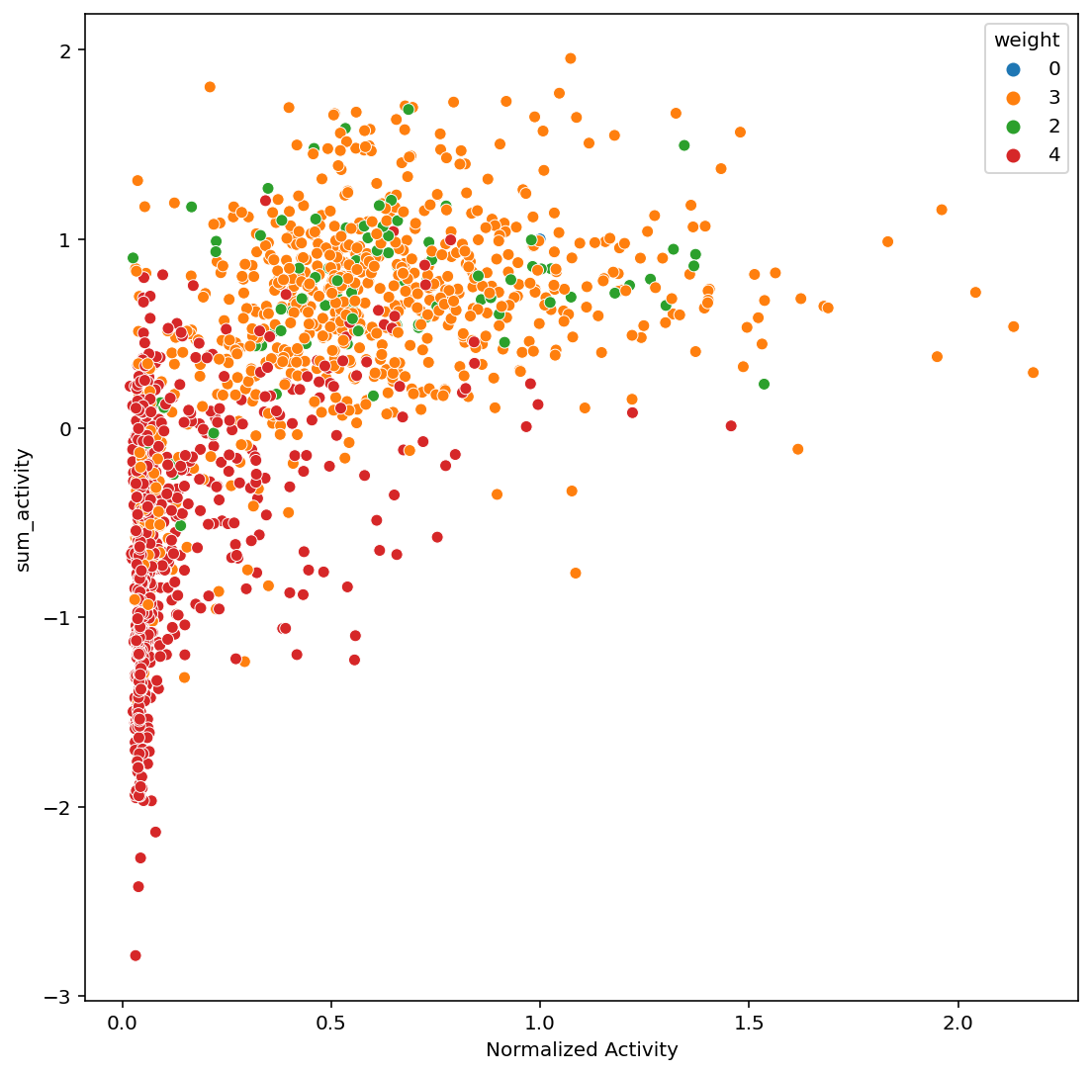
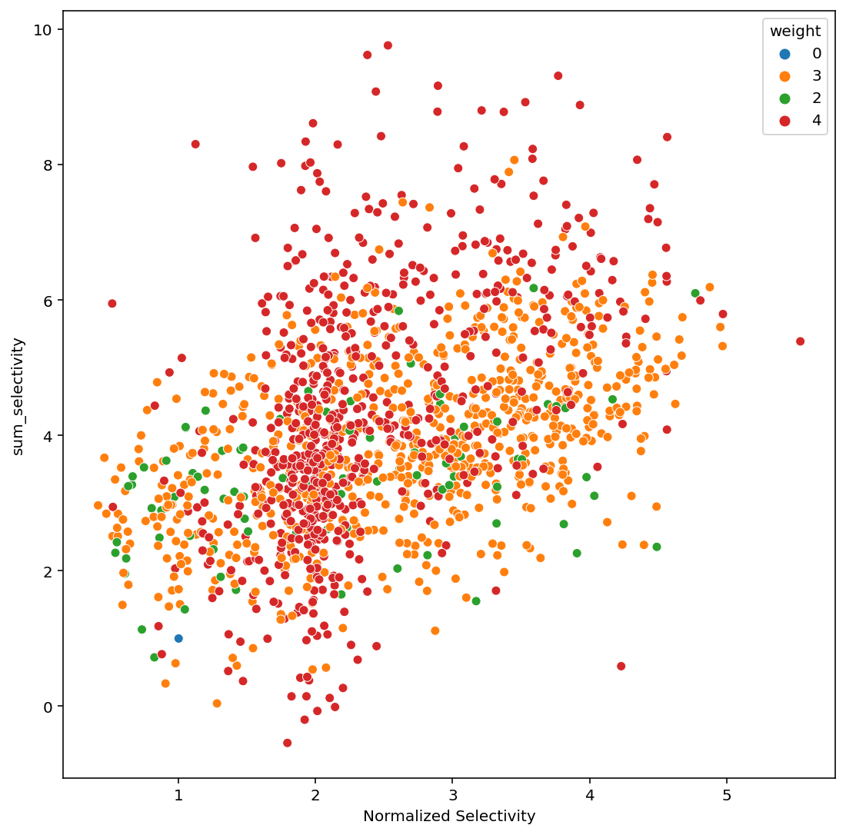

Slide 14
Linear regression v.s. Lasso regression

Slide 15
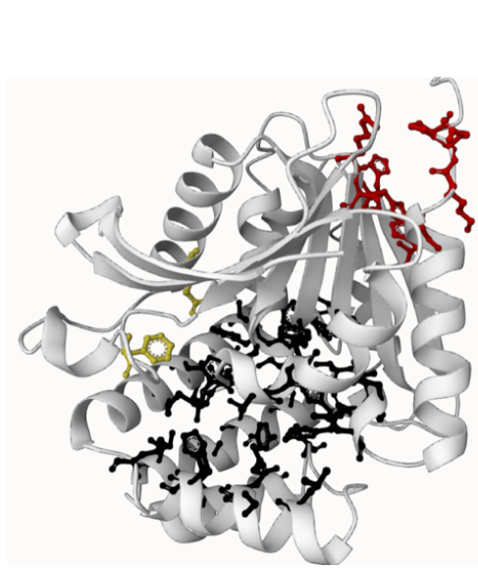
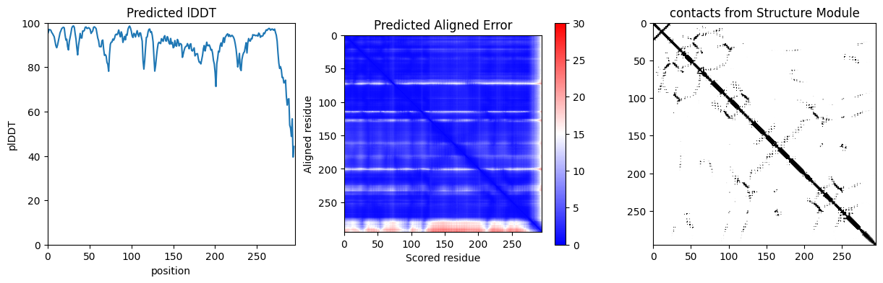
Discarded Choises
ESMfold / Protein Atlas
EDock
Epistasis anaylsis
MaxEnt (Maximum Entropy Strategy)
One-hot Encoding
Contrastive Learning

